Slide 1
ETL: Extract, Transform, Load
ETL Project: Nicole Young 03/08/2019

Slide 2
Work Application – Hotel Pricing & Transactional Data Analysis
What is the basis for this work is to Extract, Transform & Load two separate data perspectives of Hotel Pricing Data.
The first data to be examined are two sources of Competitive Pricing data including specific elements of stay date, room product, price and length of stay. This data is the product of the commercial strategies team.
The second data to be examined is transactional data which results from the purchase of hotel stays. This data is the result of customer behavior.
No less than 5 common data elements exist by which these data sources relate to one another.
A main goal is to identify the success of specific strategies, price positions by comparing and contrasting what is being sold to what is actually bought with specific parameters applied.

Slide 3
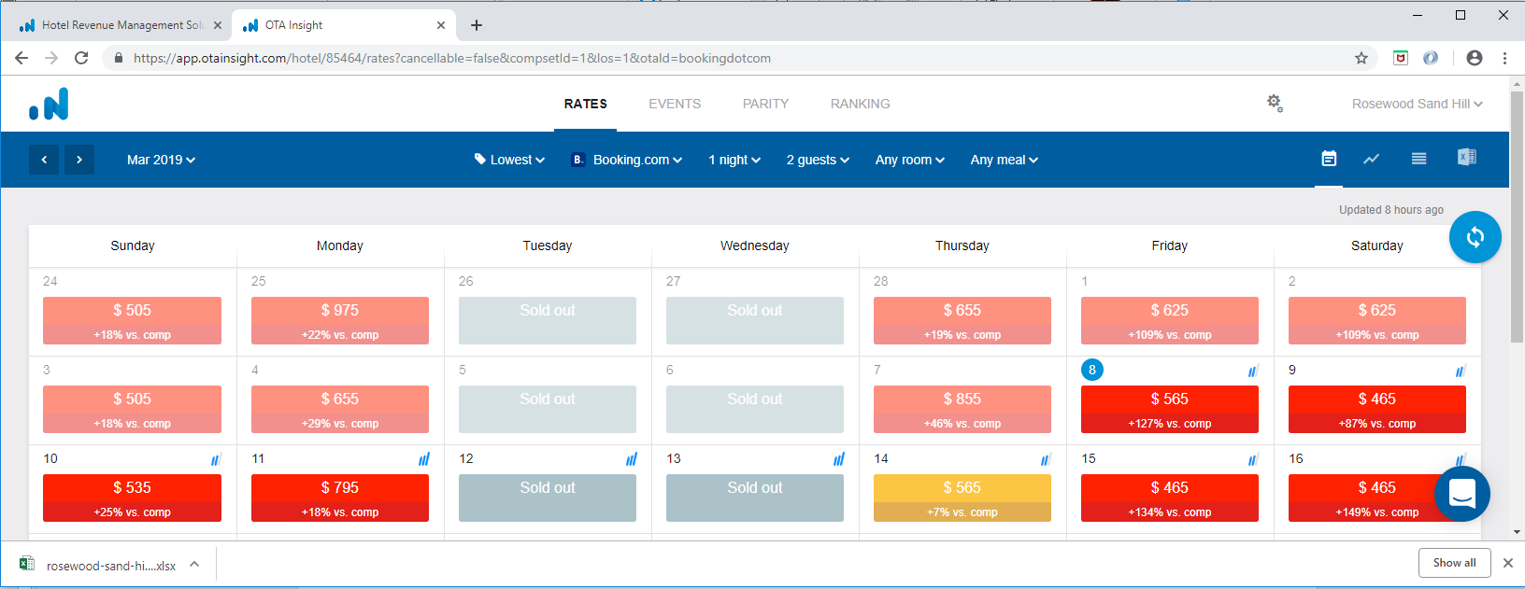
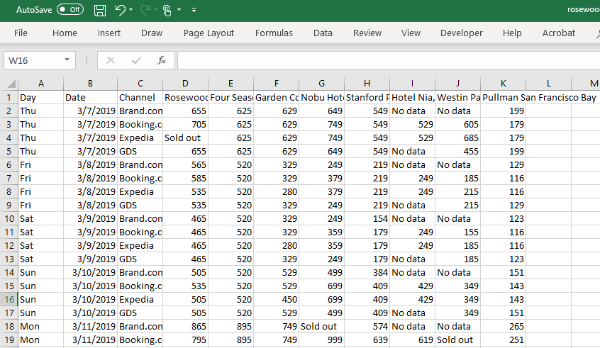
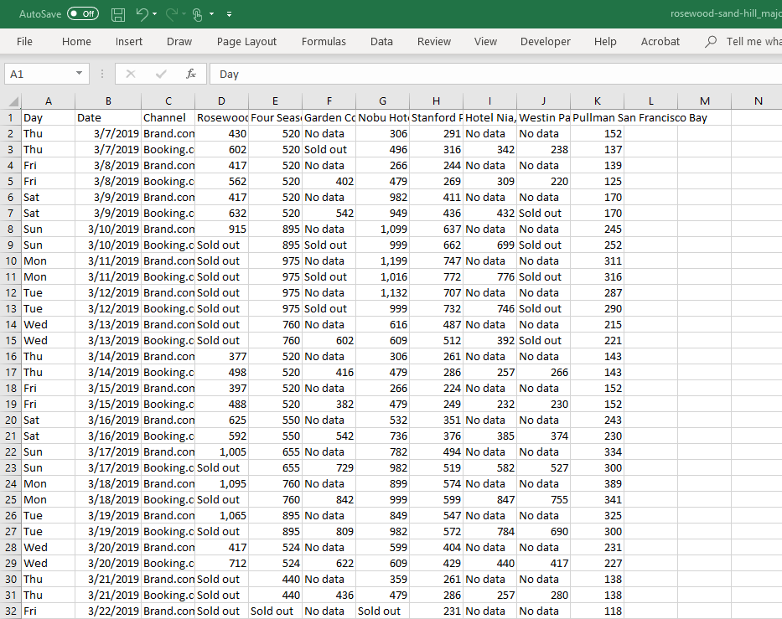
Extract
Data was rendered from a commercial hotel web scraping application into CSV for a range of dates and data parameters, encompassing 2900+ rows of pricing data

Slide 4
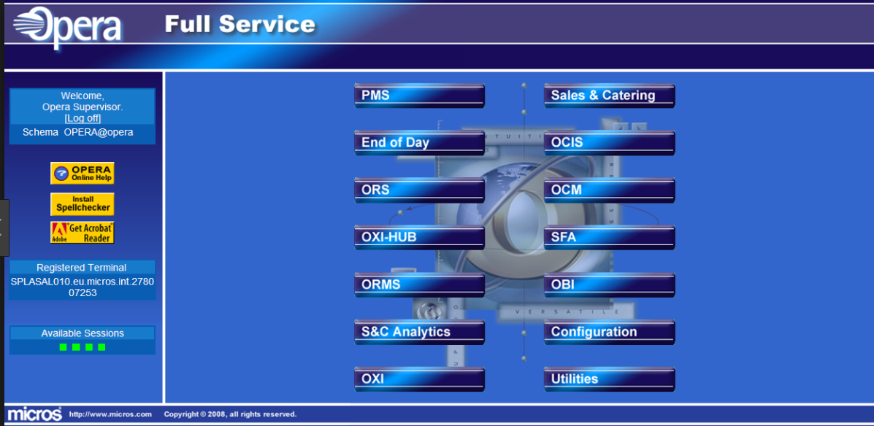
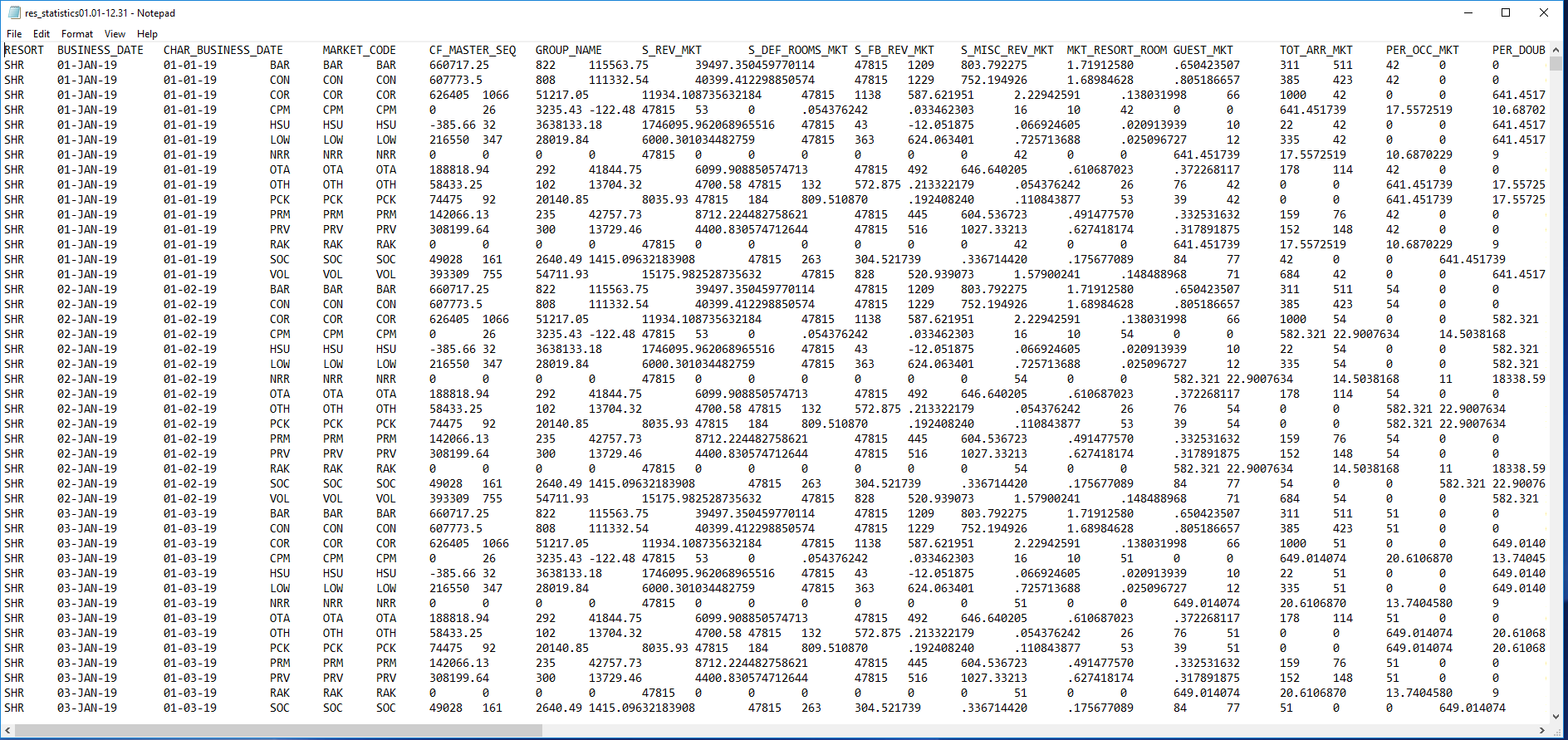
Extract
Data is rendered from an industry specific application which organizes transactional data in an Oracle Database. Queries are defined through a GUI & delivered via .txt exports. Two views of this transactional data are used, one with the primary parameter being a customers date of purchase & date of consumption.

Slide 5
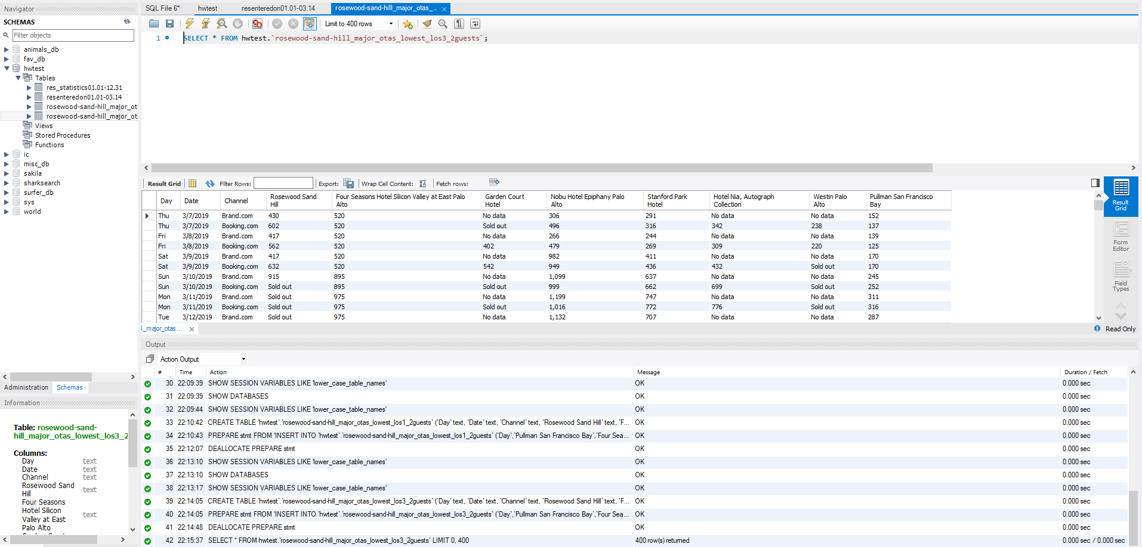
Transform
A DB called hoteprice was created and loaded with unique tables related to the four data files extracted for analysis. Adjustments to data types were necessary as were the elimination of several header rows in the originating files to ensure clean uploads

Slide 6
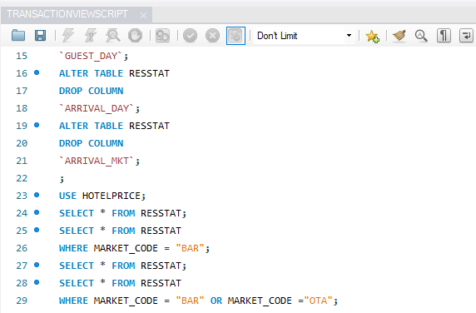
Transform
Operations performed on data sets in Workbench:
Drop irrelevant or dirty data elements
Renaming of files & tables for easy handling
Joins for pricing data file consolidation
Data formatting
Query views of select data exported to easily handled CSV’s

Slide 7
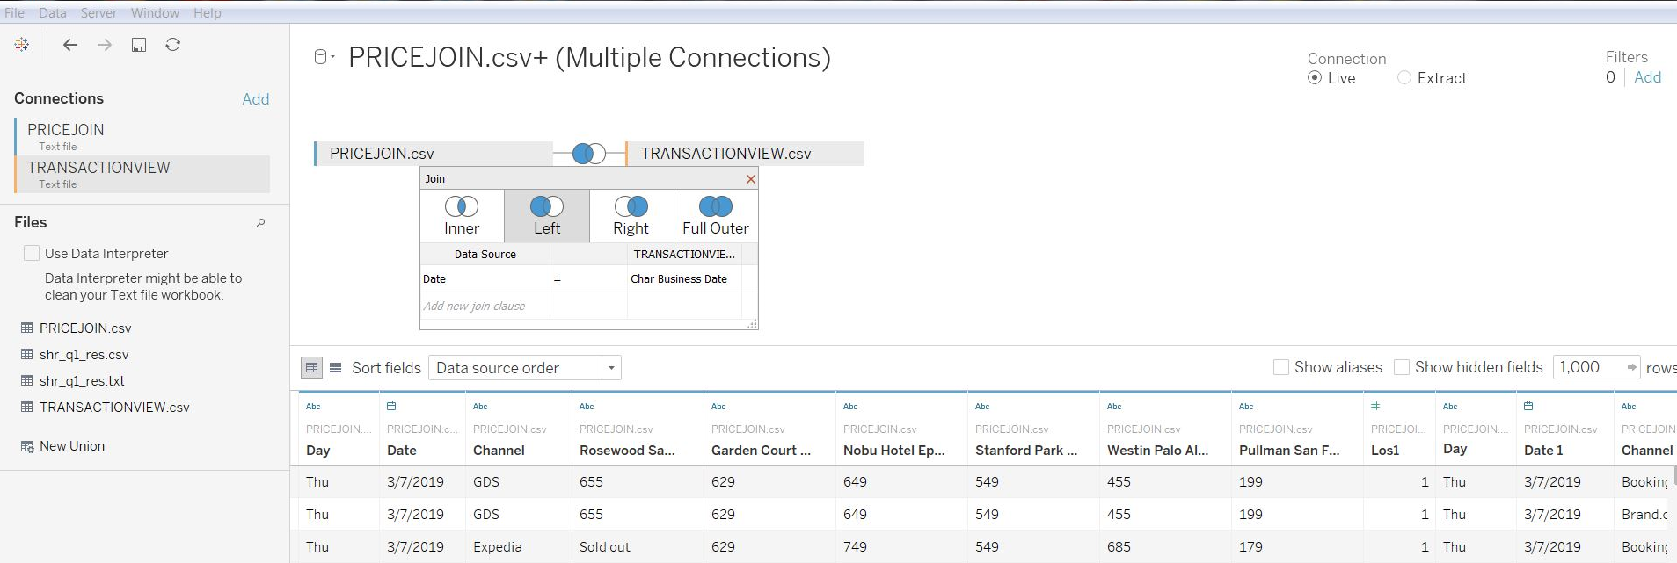
Load
Cleaned csv’s are loaded into Tableau for presentation & analysis
*because I was working between a personal and professional environment where I would automatically connect MySQL database directly to Tableau this was not possible. An extra step of exporting my query results to csv was taken they are the basis of the data loads.

Slide 8
Resulting Data Handling & Analysis
With the data cleaned and loaded I plan to perform and present the following analysis:
Aggregation of Pricing vs. Value of purchased transactions
Regression analysis to predict what volume and value of transactions will result from current available pricing
Benchmarking form Competitor pricing to our own transactions by date
Trend is price/purchase efficiency by time period (date, month, day of week)

